Slide 1

ESDM TEAM – KseNs Node and Gateway Suman M K USN:01FE18BEC188 Sriram Joshi USN:01FE18BEC183 Siddhalingeshwar R USN:01FE18BEC177 Harsha Vardhan USN:01FE18BEC199 12/05/2021

Slide 2
ABSTRACT
Internet exploration has changed the world entirely. This brought almost every individual closer than ever before to one another.Increasing the community and urbanization, the towns must revolutionize and remodel to smart cities that can be achieved with the help of the IoT.
Water is one of the essential resources for the existence of human life and so, in a smart city , smart water management system plays an important role. Owing to the lack of standardization of testing and administration facilities, a framework is introduced that enables the consumer control the quantity of water used in order to carry out efficient water usage and design a system that supports multiple communication protocols in-order to meet the requirements of the consumer.It provides details of the water usage of different buildings in the premises involved, so that the individual can control and monitor the use of water on a large scale.The system is designed for KLE campus, Hubballi as a test bed. The automated system helps the user, monitor the amount of water consumed in various buildings using the consumption details provided by the system
12/05/2021

Slide 3
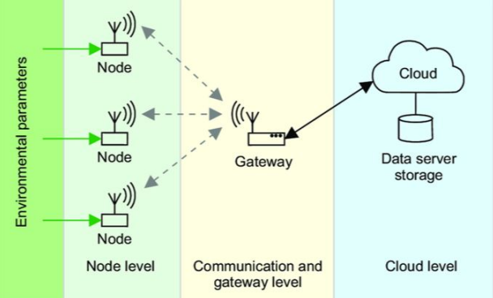
FUNCTIONAL BLOCK DIAGRAM
12/05/2021

Slide 4
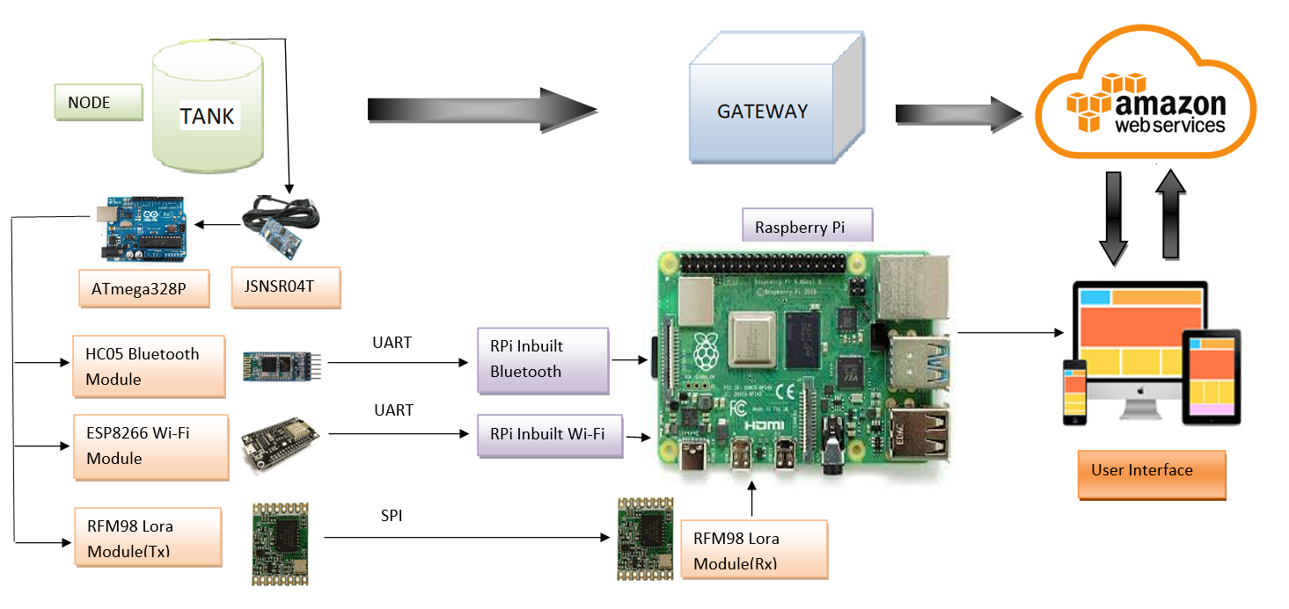
SYSTEM ARCHITECTURE

Slide 5
The project proposes the use of sensors and analytics to design smart water management.
1.It has two phases as per the architecture:
(a) Processing the raw data from sensor node (tank) and transmitting the processed data.
(b) Recieving the processed data at the Gateway and making the data available for visualization.
2. The proposed system constitutes the following modules at the Transmitter end:
ATMega328p-microcontroller, JSNSR04T - water level detection sensor and Bluetooth , ESP8266 and RFM98(tx) as networking modules.
3. The proposed system constitutes the following modules at the Receiver end: Raspberry pi, and RFM98(rx) as networking module
12/05/2021

Slide 6
4. Data processing: Sensors deployed in every overhead tank provide the distance of water from tank surface in centimeters. The controller in each overhead tank is designed to capture sensor data and place it in CSV format. The data is then transmitted using any of the communication protocols and modules based on the range constraints. The type of data published is as follows: ”unit”: ”cm” ”level”: 25 ˆ ” Node ID”: 1 ”type”: ”water level” ’Level’ indicates the water level in the unit, centimeters, as sensed by the ultrasonic sensor. ’Node ID’ represents the tank from which node data is being received.
5.a. If range required is less than 15m ,then Bluetooth communication is used. The hc05 at the transmitter end establishes Bluetooth communication with inbuilt Bluetooth of Rpi and the data is transmitted.
b.If range required is upto 400m,then Wi-Fi is used. The ESP8266 connects with inbuilt Wi-Fi of Rpi and the data is transmitted.
c.If range required is more than 800m,then LoRa communication is used. The RFM98 configured as transmitter through SPI communication transmits the data to RFM98 configured as receiver at the gateway.
12/05/2021

Slide 7
REFERENCES
1] P Mohammed Shahanas, K Bagavathi Sivakumar. Framework for a smart water management system in the context of smart city initiatives in india. pages 142–147. IEEE, 2016.
[2] I. peh O. Juki and I. Hei. Cloud-based services for the internet of things. pages 0372–0377. IEEE, 2018.
[3] R. Prajapati S. Yadav S. Wadekar, V. Vakare and V. Yadav. An internet of things- based model for smart water management. pages 821–826. IEEE, 2016.
[4] R. Prajapati S. Yadav S. Wadekar, V. Vakare and V. Yadav. Smart water management using iot. pages 1–4. IEEE, 2016.
[5] Irjet.net [6] https://www.pantechsolutions.net/iot-based-water-management-system-using-raspberrypi.

Slide 8
THANK YOU
12/05/2021

